Slide 1

WAY TO ENTERPRISE
AWS
VTI ACADEMY
Author: duy.nguyenngoc1@vti.com.vn

Slide 2
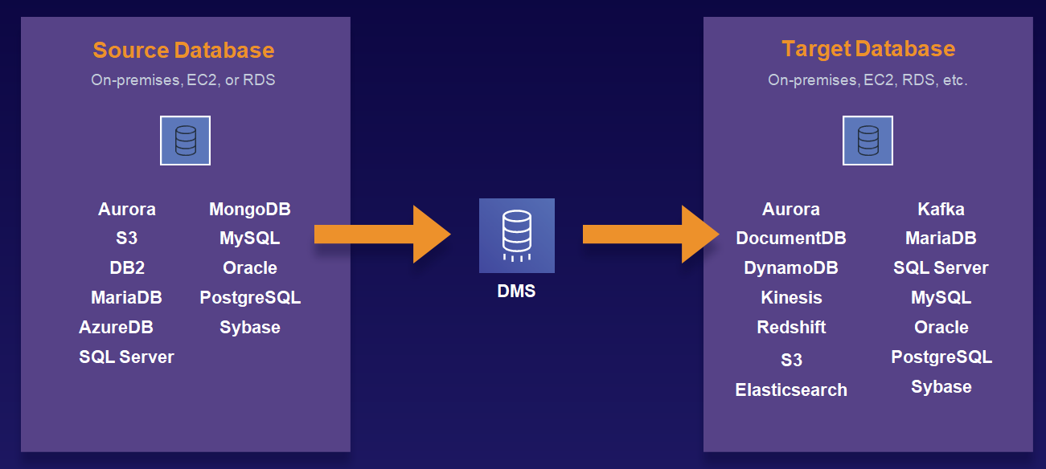
Database Migration Service
Is a service that allows to migrate data stores together
Support AWS resources: S3, RDS, DynamoDB, Data Warehouse, ElastiCache, …
Support cloud & cloud, On-premises & Cloud
Not support On-premises & On-premises
Replicate On-premise & AWS
Tutorial: https://docs.aws.amazon.com/dms/latest/userguide/Welcome.html

Slide 3
Database Migration Service
Database type may be different type
  Homogenous (same type)
  Heterogeneous (different types)
You can migrate tables, views, indexes, triggers, ...
Migration is done, you can't use it right away
Regional service
Price: https://aws.amazon.com/dms/pricing

Slide 4
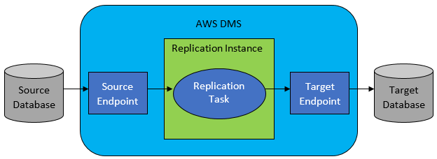
Database Migration Service
Flow
  DMS connect to data store source
  Replication Instance read data & format data by data store target
  Load data to target data store
Using transaction

Slide 5
Database Migration Service
Demo
  Database on EC2 & RDS: https://www.youtube.com/watch?v=vr5xpJi1EEU
  RDS & S3: https://www.youtube.com/watch?v=ncBG_fVCOQc

Slide 6
Assignment
  Self-practice

Slide 7
Database Migration Service
Components
  Replication instance
  Source & Target endpoint
  Replication task
  AWS Schema Conversion Tool (AWS SCT)

Slide 8
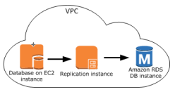

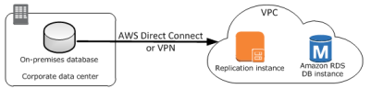
Database Migration Service
  Replication instance
    As an EC2 Instance performing replication tasks, relevant software installed
    Config:
      Instance type
      VPC, Subnet, Zone & Security Group & ACL
        Instances can connect to each other via VPC, VPN, Direct Connect, VPC Peering
VPC Peering
VPN /Direct Connection
VPC

Slide 9

Database Migration Service
        You can grant Public IP/NAT Gateway for instances to connect via the internet
      Multi A-Z & Auto failover
      Maintenance

Slide 10
Database Migration Service
  Source & Target endpoint
    Create connection to data store source & target
    An endpoint will connect to a data store
    Support Database run on on-premises or AWS
    Config:
      Source engine type: RDS, DynamoDB, S3, …
      Target engine type: RDS, DynamoDB, S3, Redshift, ElastiCache, Neptune, …
      Credential: Servername, Port, Database Name, Username, password / IAM Role

Slide 11
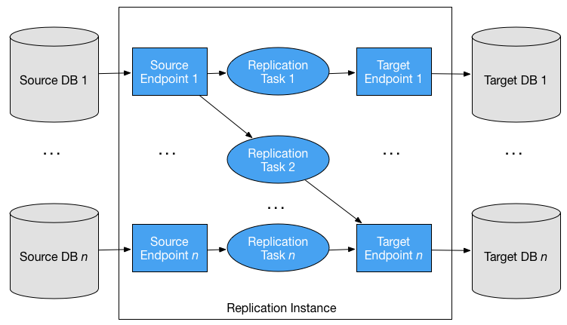
Database Migration Service
  Replication task
    Create task to migrate data between 2 data stores
    Config:
      Replication instance
      Source/Target Endpoint
      Migration type
        Migrate existing data (Full Load)
        Migrate all existing data

Slide 12
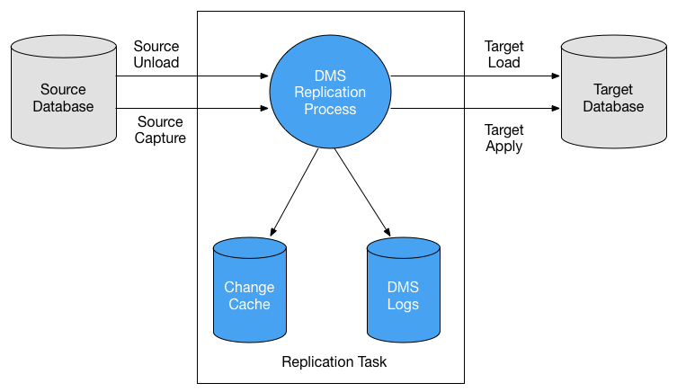
Database Migration Service
        Migrate existing data and replicate ongoing change – cache change (Capturing changes during migration, full-load-and-cdc)
        Migrate data + while migrating, the source database still has changed data
        Replicate data changes only (Capturing changes during migration)
        Migrate only the parts of the source Database that change
      Support validate after migration
      Support SNS, CloudWatch Log, …

Slide 13
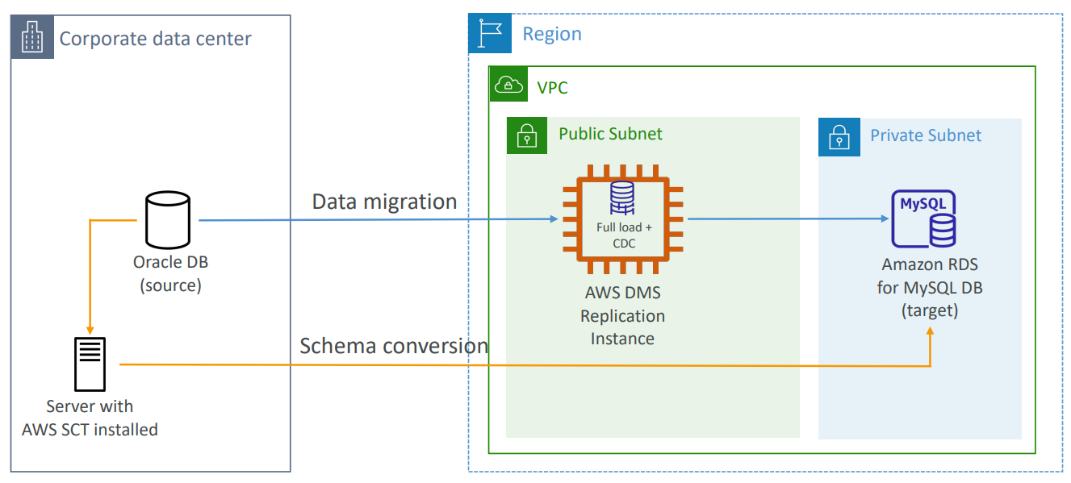
Database Migration Service
  AWS Schema Conversion Tool (AWS SCT)
    DMS only supports basic commands such as create table, rename, ... insert into, update, ...
    SCT using for migrating schema, procedure, function between different data stores
    Example: schema from RDS to data warehouse

Slide 14
Assignment
  Self-practice

Slide 15
Summary
  DMS is a service that allows to migrate data stores together
  Support cloud & cloud, On-premises & Cloud, Not support On-premises & On-premises
  Database type may be different type
  You can migrate tables, views, indexes, triggers, ... 🡺 Using AWS Schema Conversion Tool
  Source engine type: RDS, DynamoDB, S3, …
  Target engine type: RDS, DynamoDB, S3, Redshift, ElastiCache, Neptune, …

Slide 16
Summary
  Migration type
    Migrate existing data (Full Load)
    Migrate existing data and replicate ongoing change
    Replicate data changes only

Slide 17
Q & A
Copyright © VTI Academy All Rights Reserved

